Slide 1
TATA iQ
Unix Training

Slide 2
OS Introduction

Slide 3
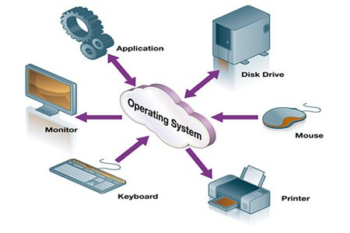
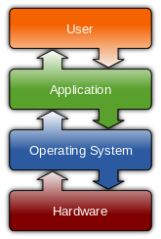
What is an OS & why do we need OS?
The operating system (OS) is the most important program that runs on a computer
Notes:
Operating systems perform basic tasks, such as recognizing input from the keyboard, sending output to the display screen, keeping track of files and directories on the disk, and controlling peripheral devices such as disk drives and printers

Slide 4
Different types of OS
Features | Windows | Mac | Unix | z/OS
User Interface | Excellent ( Easy to understand) | Excellent( Easy to understand) | Good (Needs some practice to understand) | Medium ( Very difficult )
Security | Moderate | High | Highly Secure | Highly Secure
Compatibility | Runs on any hardware | Runs only on Apple | Any Hardware | Any Hardware
Performance | Slow( too many apps running) | Slow | Fast | Fastest
Reliability | Relatively Stable because the application needs to be secure on a regular basis. | Better than Win, because of its restriction on hardware. Still apps needs to be updated | Stable, not too many apps running. | Highly stable.
Cost | Expensive | Expensive | Cheapest | Most Expensive
Machines/HW | Laptop and desktops | Laptops and desktops | smaller, less critical Mainframe application or servers | Heavy Mainframe server applications.
Notes:
Create a question type slide for different type of os

Slide 5


Quiz Time
When was Unix developed first and by whom?
1969. Developed by K Thomson, Dennis Ritchie

Slide 6

Why is learning Unix Important ??

Slide 7
Why Unix?
Unix is secure and most tools are free
Configuration is simple. Another of Unix's big philosophies is that configuration files should be easy to maintain.
Unix systems are easy to automate, and easy to program for.
Uptime is much better on a Unix system than a Windows one.
Licensing is simple.
Google says there are around 139,000 results for an image search for "unix family tree" - so describing the history of UNIX is clearly something a LOT of people have put time into.

Slide 8


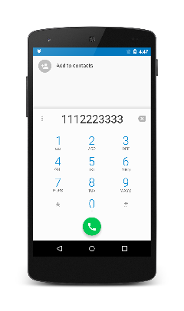



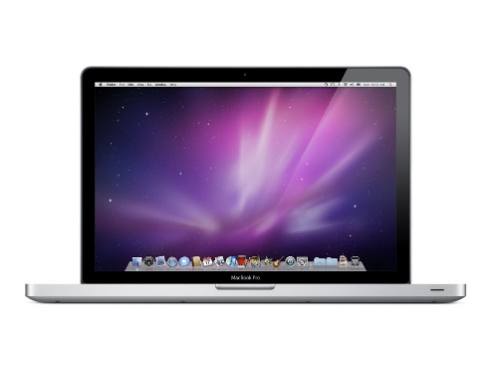








Unix is Everywhere!!!

Slide 9
Quiz Time
In What Language Unix was written?
Written in B first by K. Thomson, then rewritten in C by Dennis Ritchie.

Slide 10



Unix Facts
For those who think Unix can’t do Animation – Oscar-winning visual effects of the Titanic by James Cameron came from machines with Linux and Avatar was the last movie completely developed in 3D Applications on Linux platform using Foss Software. Exclaimed!

Slide 11
Intro to Unix

Slide 12
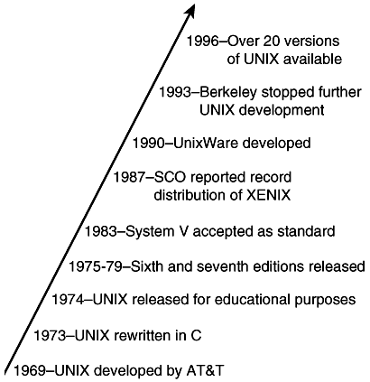
History of Unix?
Written by Ken Thompson and Dennis Ritchie
Developed at Bell Laboratories, USA derived from Multics(1969)
Firstly developed in ‘B’ then rewritten in ‘C’
Two Flavours
  System V ( Commercial run by AT&T)
  BSD (Educational, run by Bell Labs)
Recent Development are graphical interface
  Motif, X windows, open view
Major Suppliers
  Sun, IBM, HP, DEC
Free and open source Unix System is call Linux
  Ubuntu, Debian, CentOS, Fedora, Red hat,

Slide 13
Different Flavours of Unix
Proprietary Flavours
  AIX - developed by IBM for use on its mainframe computers
  BSD/OS - a commercial version of BSD developed by Wind River for Intel processors
  HP-UX - developed by Hewlett-Packard for its HP 9000 series of business servers
  IRIX - developed by SGI for applications that use 3-D visualization and virtual reality
  QNX - a real time operating system developed by QNX Software Systems primarily for use in embedded systems
  Solaris - developed by Sun Microsystems for the SPARC platform and the most widely used proprietary flavor for web servers
  Tru64 - developed by Compaq for the Alpha processor

Slide 14
Different Flavours of Unix contd…
Open Source Flavours
  Linux - the most popular and fastest growing of all the Unix-like operating systems
  FreeBSD - the most popular of the BSD systems (all of which are direct descendants of BSD UNIX, which was developed at the University of California at Berkeley)
  NetBSD - features the ability to run on more than 50 platforms, ranging from acorn26 to x68k
  OpenBSD - may have already attained its goal of becoming the most secure of all computer operating systems
  Darwin - the new version of BSD that serves as the core for the Mac OS X

Slide 15
Quiz Time
Linux is named after whom?
Linux Kernel was written by a 21 year finishing college student as a part of his hobby. Yup! His name is Linus Torvalds.

Slide 16
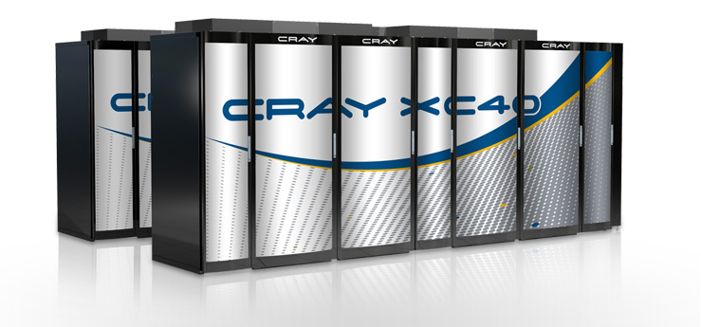
Unix Facts
90% of the world’s most powerful supercomputers are using GNU/Linux. Top ten of supercomputers use Linux. 33.8% of the world runs on Linux servers compared to 7.3% running Microsoft Windows operating system.

Slide 17
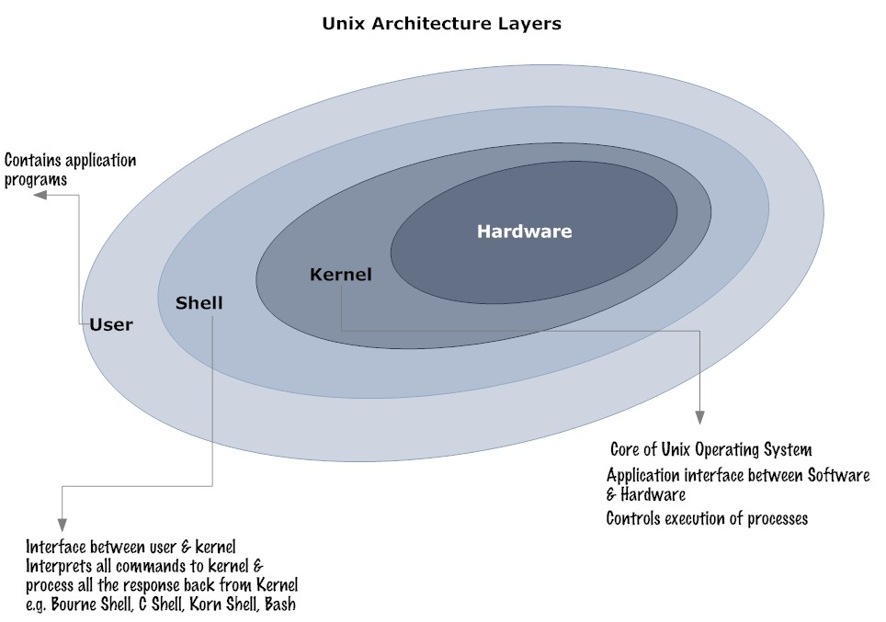
Unix System Architecture
The hardware at the center of the diagram provides the operating system with basic services.
Basic Unix Components:
  Kernel – directly talks
  Shell - acts as a bridge between kernel and users
  Utilities - UNIX provides several hundred utility programs, often referred to as commands.
The user programs are independent of the underlying hardware
Notes:
Add a slide before this, may be a picture, explaining connections b/w OS and Kernel

Slide 18
Quiz Time
What are biggest Linux distributors?
Linux Mint followed by Debian and Ubuntu

Slide 19


Unix Facts
Believe it or not – In 2002, Microsoft had accumulated a $ 421 million cost of fighting the spread of Linux, according to The Register.

Slide 20
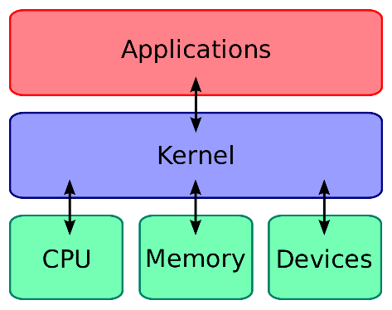
Kernel
The kernel is a computer program that constitutes the central core of a computer's operating system. It has complete control over everything that occurs in the system.
It is the first program loaded on start-up, and then manages the remainder of the start-up
Notes:
Add a slide before this, may be a picture, explaining connections b/w OS and Kernel

Slide 21

Shell
The shell is a program that takes your commands from the keyboard and gives them to the operating system to perform.
Shell is a UNIX term for the interactive user interface with an operating system also known as command line interface(CLI)
The following is a list of commonly used shell programs:
  The Bourne Shell (sh)
  The C Shell (csh)
  The Bourne Again Shell (bash)
  The Korn Shell (ksh)
Notes:
pros and cons of bash, ksh and sh
Tell why bash is the most popular

Slide 22
Shell Comparison
Shell Features | sh | csh | ksh | bash
Job control | N | Y | Y | Y
Aliases | N | Y | Y | Y
Shell functions | Y | N | Y | Y
Command history | N | Y | Y | Y
Vi Command line editing | N | N | Y | Y
User name look up | N | Y | Y | Y
Builtin artithmetic evaluation | N | Y | Y | Y
Process Substitution | N | N | N | Y
Freely Available | N | N | N | Y
Can cope with large argument lists | Y | N | Y | Y
Can specify startup file | N | N | Y | Y
Local variables | N | N | Y | Y
Notes:
pros and cons of bash, ksh and sh
Tell why bash is the most popular

Slide 23
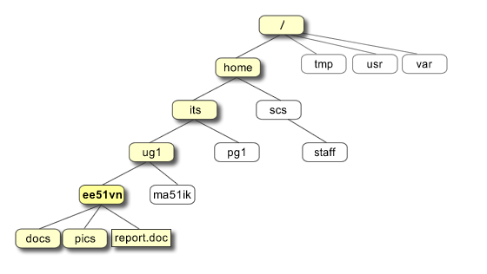
Unix File System
Everything in UNIX is either a file or a process.
  A process is an executing program identified by a unique PID
  A file is a collection of data. They are created by users using text editors, running compilers etc. (Directory is also a file)
All the files are grouped together in the directory Structure
The top of the hierarchy is traditionally called root.
Notes:
pros and cons of bash, ksh and sh
Tell why bash is the most popular

Slide 24

Unix Facts
Microsoft started supporting Unix starting 2016 from Win10

Slide 25



File Types
Different types of files
  Ordinary or Regular Files
  Directories
  Device (Special) Files
  Links
  Named Pipes
  Sockets
Notes:
pros and cons of bash, ksh and sh
Tell why bash is the most popular

Slide 26
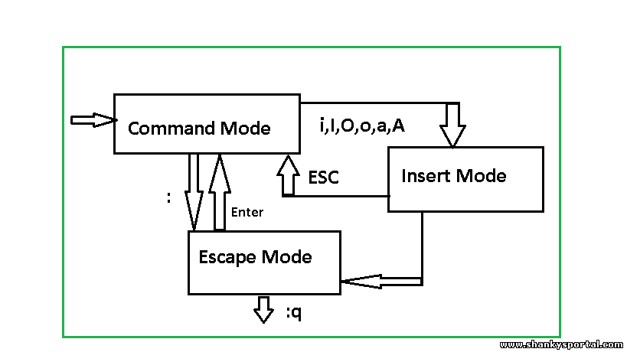
Create & Save file - Vi Editor
Command | Description
vi filename | Creates a new file if it already does not exist, otherwise opens existing file.
vi -R filename | Opens an existing file in read only mode.
view filename | Opens an existing file in read only mode.
Notes:
pros and cons of bash, ksh and sh
Tell why bash is the most popular

Slide 27

Linux Facts
The Linux kernel’s official mascot is a penguin named Tux, abbreviation of tuxedo. The idea that Linux had a pet penguin comes from Linus Torvalds himself.

Slide 28
Unix Commands
Notes:
Why Commands

Slide 29
Quiz Time
How do you get help about the command "cp"?
> man cp

Slide 30
Commands – UNIX Log In and Out Commands
Command | Description
login | Logon command
logout | Logout command
passwd | Change password
exit | Exit the terminal
shutdown | Shutdown the system.
Notes:
Talking point: explain diff b/w exit and shutdown; what happens if they don’t shutdown;

Slide 31
Commands – UNIX Information Command
Command | Description
man [-option] [command] | Manual or UNIX help command. The usual quit sequence `q (CR)' can be used to quit long UNIX `man' listings, `(CR)' is used for new `man' pages. During a IBM Telnet session the `Clear-key' is needed for new CMS pages that are not the same as the `man' pages. Otherwise `d', `q' or `Ctrl-c' should work for UNIX like access.
whereis [name] | Locates source for program or command; e.g. `whereis kermit'.
which [name] | Tell which version of a program or command will be used in your session in case of multiple copies; e.g. `which cc'.
whatis [command] | Describes the command [command].
whoami | Displays current user id and access.
who | Displays currently logged in users.
Notes:
Examples for each command:

Slide 32
Commands – UNIX Directory Commands
Command | Description
mkdir [name] | Makes a directory or file group name [name]; e.g. `mkdir dirpgm' make the directory called `dirpgm'.
pushd [name] | Pushes from the working directory to the directory [name] keeping the sequence of directories in a buffer for `popd'.
popd | Pops back up to the prior directory, if `pushd' was used before. For this reason, `pushd' and `popd' are more useful than the regular change directory command `cd'.
cd [directory] | Changes the working directory to the directory [directory]; you can change it back with `cd' using your own login id; `cd $HOME (CR)' returns the shell back to your home directory. `.' denotes the current directory and `..' denotes the root or parent directory.
cd ~[user] | Changes working directory to that of login id `[user]'.
cd $HOME | Changes to your home directory.
pwd | Displays present working directory
ls [directory] | Displays the contents of the directory `[directory]'.
mv [file1] ... [fileN] [directory] | Moves `[file1]', ..., `[fileN]' to directory `[directory]'; e.g. `mv addtwo.* diradd' moves all files with prefix `addtwo.' to the directory `diradd'.
cp [file1] [directory]/[file2] | Copies [file1] into [file2] in directory [directory]. `cp [file] . (CR)' copies a file to the current directory using the original name. This format works for `mv' also.
rmdir | Removes or erases empty directory. You must first use `rm *' to empty the file.
rm | Remove files or directories (options i-interactive, f-force, r-recursive). Be careful while using option force or recursive.
Notes:
Talking point: use ls to show file size in GB

Slide 33
Commands – UNIX File Commands
Command | Description
ls | Lists sets or files of current user id or current directory.
ls ~[user] | Lists files or directories under user/account id `[user]'. Also `ls ~/[directory] (CR)' will list the contents of the directory `[directory]' on the same account.
ls [string].* | Lists all current files with prefix [name]. Examples of other forms are `ls *[string] (CR)' or `ls *[string]* (CR)' or `ls *[string1]*[string2]*'.
cat [file1] ... [fileN] | Lists content of N (N .le. 1) argument files catenated. Use `cat [file1] ... [fileN] > [fileM],' to catenate and store the N files in `[fileM]'.
more [file] | Displays file in half pages of 11 lines; use `q (CR)' for quitting; use `d' for 11 more lines or `u' to go back up 11 more lines; similarly, `f' and `b' produce full pages forward and backwards, respectively;
cp [file1] [file2] | Copies file `[file1]' into file `[file2]'.
rm [file1] | Erases file `[file1]'; can take several file arguments, with the system asking if you really want to do it, `y' for yes and `n' for no target file `[file2]' already exists to avoid unintentional.
mv [file1] [file2] | Renames file `[file1'] as file `[file2]', i.e., moves one file to another.
grep `[str]' [file1] | Searches for string [str] in file [file1]. ``cat [file1] [file2] | grep `[string]' (CR)'' searches for the pattern `[string]' in the catenated files.
diff [file1] [file2] | Displays the difference between files `[file1]' and `[file2]'.
chmod [mode] [file] | Changes the read, write and execute permissions for the file (or files) `[file]' according to the `[mode]' which has form `[[who] [operator] [permission]]'; `[who]' is `u' for the user, `g' for the defined group', `o' for others and `a' = `ugo' for all; `[operator]' is `+' to add and `-' for remove; `[permission]' is `r' for read, `w' for write and `x' for execute; Ex1: chmod u+rwx filename Ex2: chmod 757 filename
wc filename | Used to get a count of the total number of lines, words, and characters contained in a file.
file | Determines a file type.

Slide 34
Commands – UNIX Process Commands
Command | Description
jobs – l | Display a simple single line with currently active job status.
ps | Display current process ids (``pid'') needed for killing.
ps t[N] | Displays ``pid'' for terminal or tty [N].
kill [pid] | Kills a process given by pid.
kill -9 [pid] | Means a “sure kill”' or “Force Kill” of ``pid'' [pid]; this becomes necessary when you lose control of a process or have a session aborted.

Slide 35
Thank You

Slide 36
Appendix

Slide 37
Different types of OS ?
Quality | Windows | Mac | Unix | z/OS
User Interface | Excellent ( Easy to understand) | Excellent( Easy to understand) | Good (Needs some practice to understand) | Medium ( Very difficult )
Security | Moderate | High | Highly Secure | Highly Secure
Compatibility | Runs on any hardware | Runs only on Apple | Any Hardware | Any Hardware
Performance | Slow( too many apps running) | Slow | Fast | Fastest (z/OS gets extra points for being more scalable. Want to double your transaction throughput? Ask your IBM engineer to switch on more processors and you're away. Nothing else to do. A similar exercise with a UNIX environment will usually involve adding a few more UNIX servers to your cluster.)
Reliability | Relatively Stable because the application needs to be secure on a regular basis. | Better than Win, because of its restriction on hardware. Still apps needs to be updated | Stable, not too many apps running. | Highly stable. IBM proudly states that Mainframes can achieve “five nines” (99.999%) availability, or around 5 minutes unscheduled and scheduled downtime per year.
Cost | Expensive | Expensive | Cheapest | Most Expensive
Customers | Laptop and desktops | Laptops and desktops | smaller, less critical Mainframe application or servers | If you have existing critical Mainframe applications, there are lots of reasons to keep them going. As far as security, reliability and the ability to handle lots of transactions, nothing beats z/OS.

Slide 38
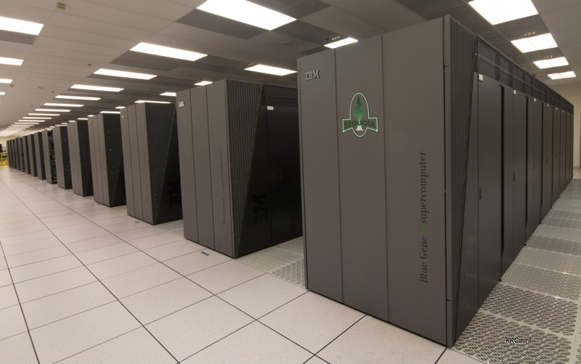

Unix Facts
IBM choose Linux for what is expected to be then world’s most powerful supercomputer, Sequoia, due in 2011

Slide 39



Linux Facts
Linux has a strong following in Smart Phones – Palm’s WebOS, Google’s Android and Nokia’s Maemo smart phone operating systems are built on top of the Linux kernel. Check Symbian and iOS

